Slide 1
STAFFING autonomy of UNIVERSITY OF ZAGREB (Faculty of Mechanical Engineering and Naval Architecture)
prof. dr. sc. Krešimir Grilec
University of Zagreb
Faculty of Mechanical Enginering and Naval Architecture

Slide 2
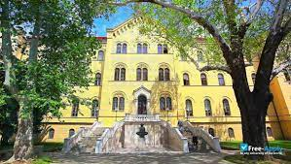
The Croatian university sector is characterised by the historically high independency of faculties.
University of Zagreb - union of independent, legally established faculties (31 faculties and 3 academies of art).

Slide 3
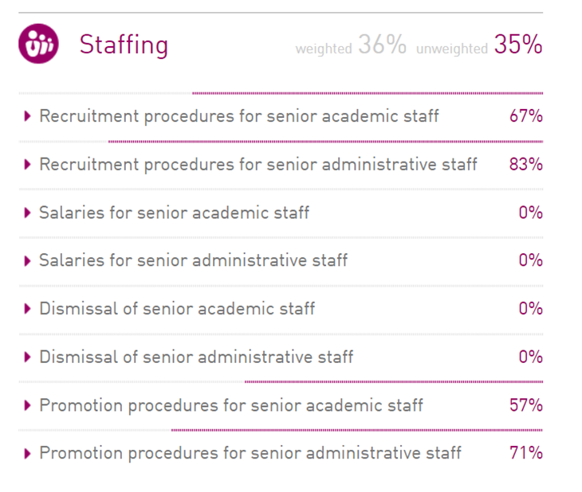
RANK by EUA: 29th in staffing

Slide 4
Recruitment procedures for senior academic staff (67%)
Appointments need to be confirmed by an external authority.
The number of posts is regulated by an external authority.
Internal: Staff Committee → Faculty Council
- financial requirements (“total cumulative coefficient”)
- the number of teachers needed for the teaching process
Scientific, teaching, professional and institutional requirements –
it is prescribed by law.

Slide 5
Faculty → University →Ministry of Science and Education
Faculty: - announcing a competition for a job
- designate internal committee for each recruitment
University: Senate or Field Council
Ministry: Parent committees (National Council for Science, Higher Education and Technological Development)
financial requirements (“total cumulative coefficient”)

Slide 6
Recruitment procedures for senior administrative staff (83%)
The number of posts is regulated by an external authority.
Internal: Staff Committee → Faculty Council
Faculty → University →Ministry of Science and Education
financial requirements (“total cumulative coefficient”)

Slide 7
Salaries for senior academic staff
Salaries for senior administrative staff
Salaries are set by an external authority/civil servant status for all staff.
Regulation on job titles and job complexity coefficients in public services (government by-law acts).

Slide 8
Total cumulative coefficient
2011. government recommendation → university decision
“The total cumulative coefficient of employees is determined as the sum of the total cumulative coefficient constantly employees as at 31 May 2011”.
Includes:
new recruitments
all promotions

Slide 9
Dismissal of senior academic staff
Dismissal of senior administrative staff
Dismissals are strictly regulated due to civil servant status for all staff.
Croatian labor law
Dismissals are subject to other regulations specific to the sector.
Collective contract for science and higher education.

Slide 10
Promotion procedures for senior academic staff (57%)
Promotions are only possible if there is a post at a higher level.
University statute: promotion after a minimum of 5 years in the previous title.
Ministry: Scientific, teaching, professional and institutional requirements.
financial requirements (“total cumulative coefficient”)

Slide 11
Promotion procedures for senior administrative staff (71%)
The law states who has to be included in the selection committee.
financial requirements (“total cumulative coefficient”)

